Slide 1

Quantum Machine Learning for image classification
Brian Recktenwall-Calvet, Haemanth V,
Hussein Shiri and A/Prof Carlos C N Kuhn

Slide 2
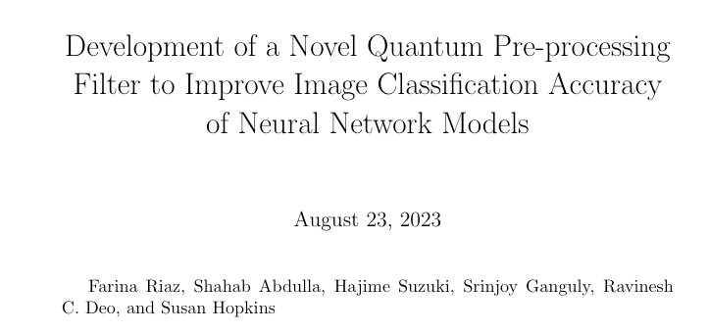
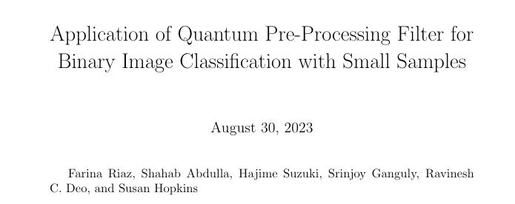
Motivation
Motivation and Background
Notes:
Following this pioneering work, where a new Kernel has been desinged

Slide 3
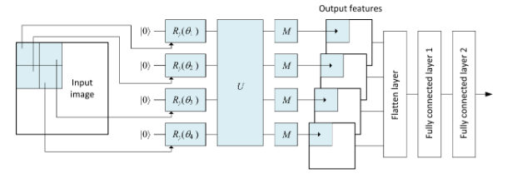
Motivation and Background
Diagram of the Filter implementation. In our study we are further investigating the implications of overlapping pixels during the embedding and also increasing the Kernel size from 2x2 to 3x3.

Slide 4
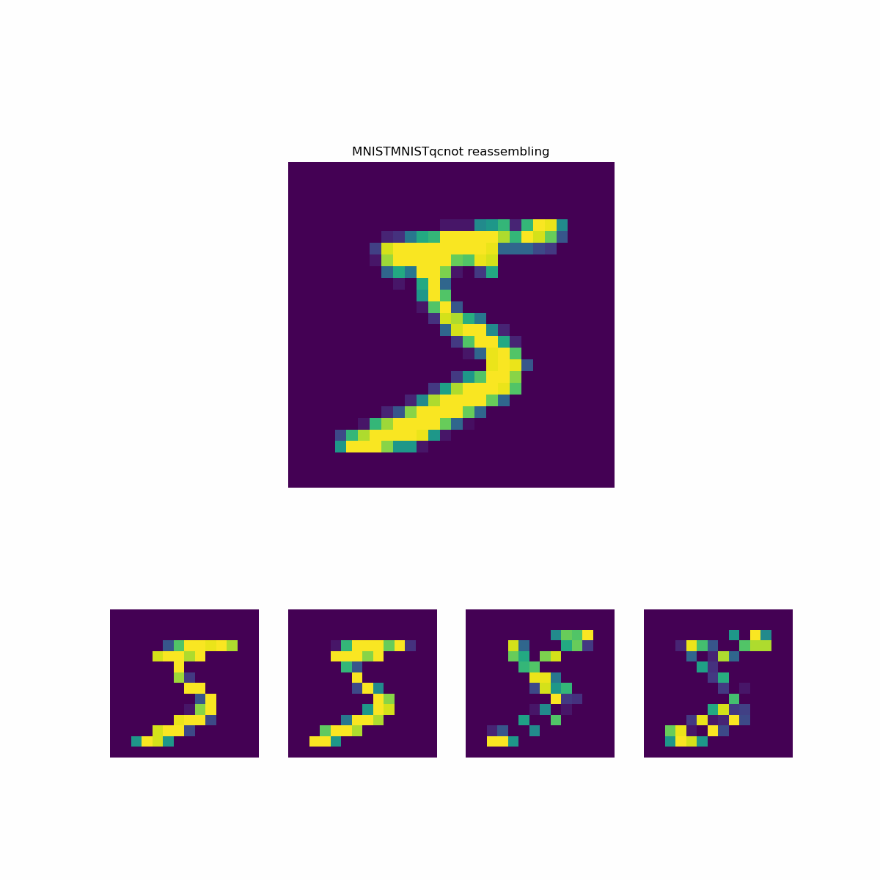

Slide 5
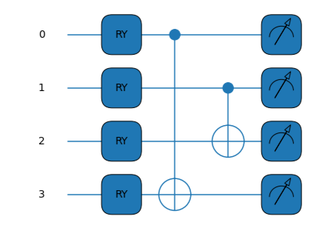
Motivation
Motivation and Background
Quantum circuit using Rx gates to encode the classical pixel information and 2 CNOTs gate to entangle the wires.

Slide 6
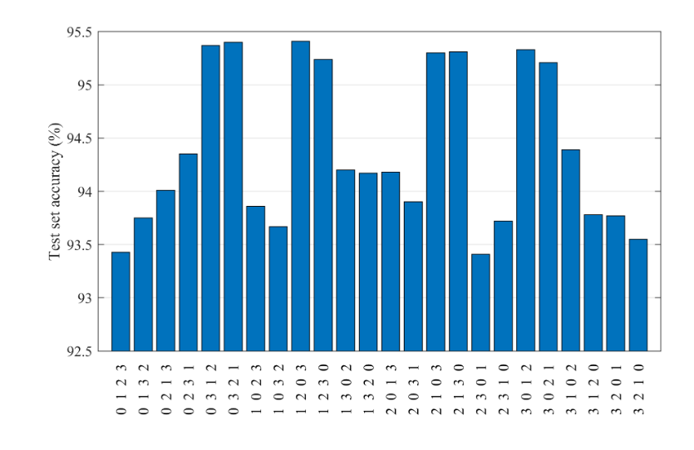
Motivation and Background
The article reports that the accuracy presents a dependency on the CNOTs arrangements:

Slide 7
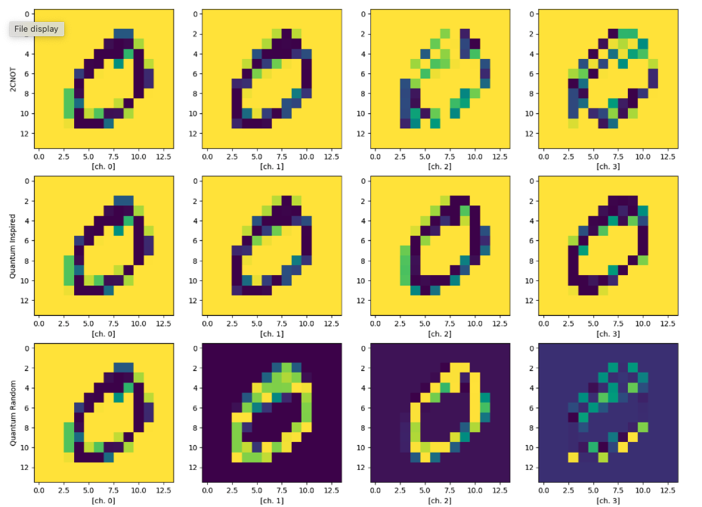
Preliminary results
Output for four channels, comparing 2 CNOTs, quantum inspired and Quantum Random Circuit

Slide 8
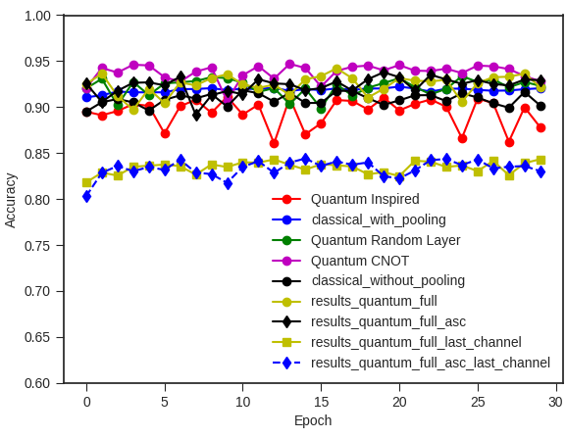
Preliminary results
The article reports that the accuracy presents a dependency on the CNOTs arrangements:

Slide 9
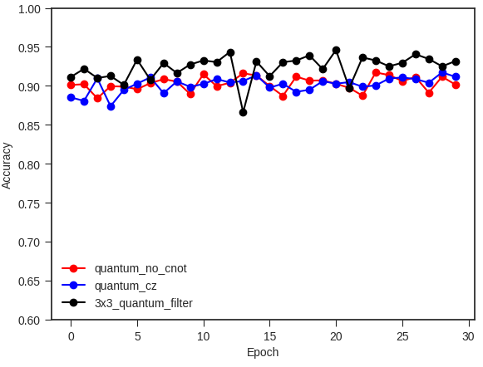
Preliminary results
Checking accuracy using a bigger kernel

Slide 10
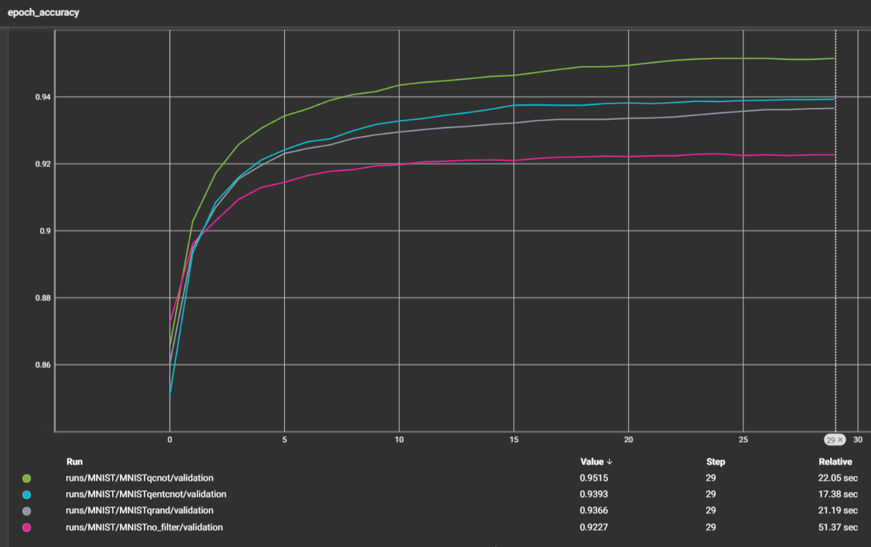

Slide 11
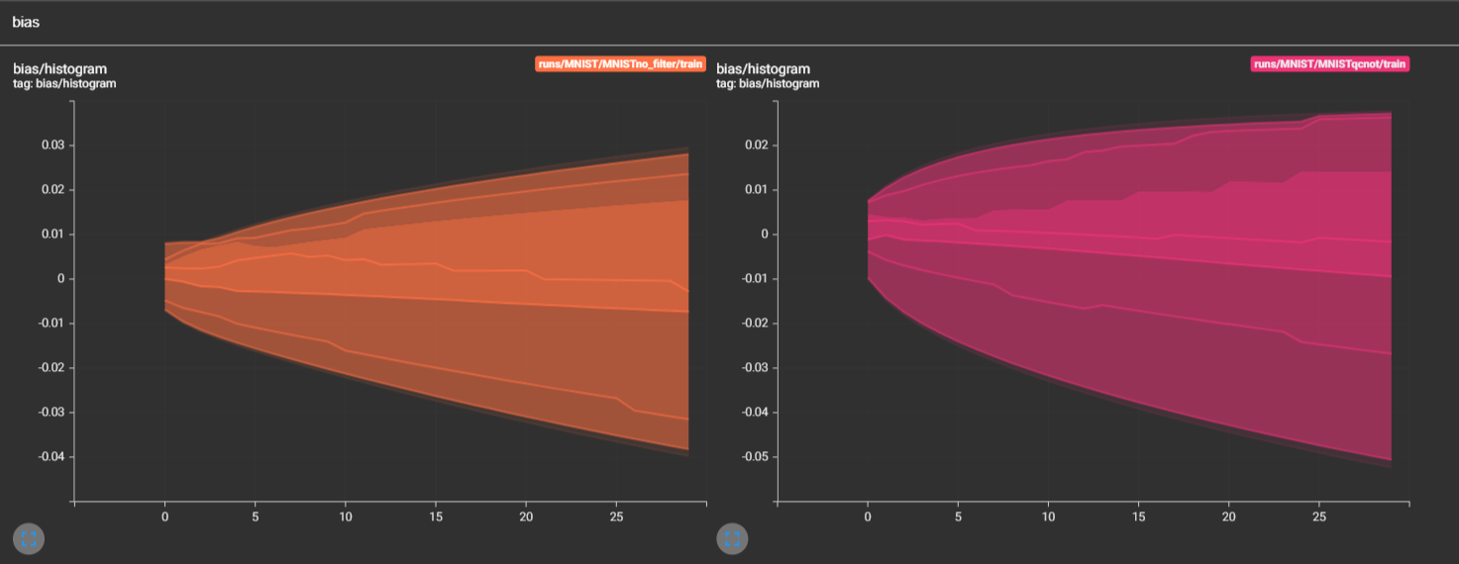
Evolution of Epoch Bias

Slide 12
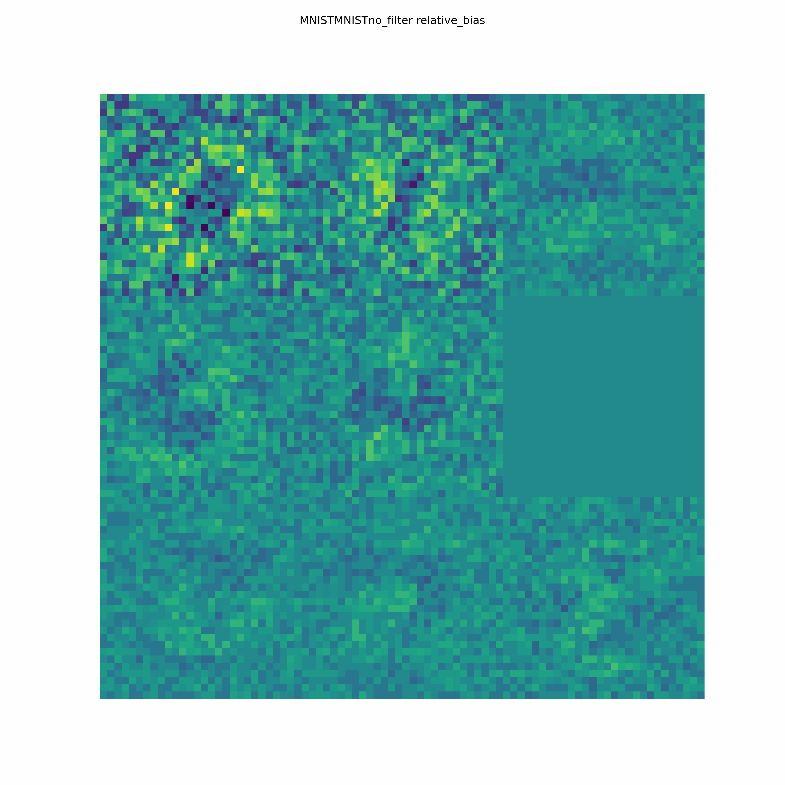
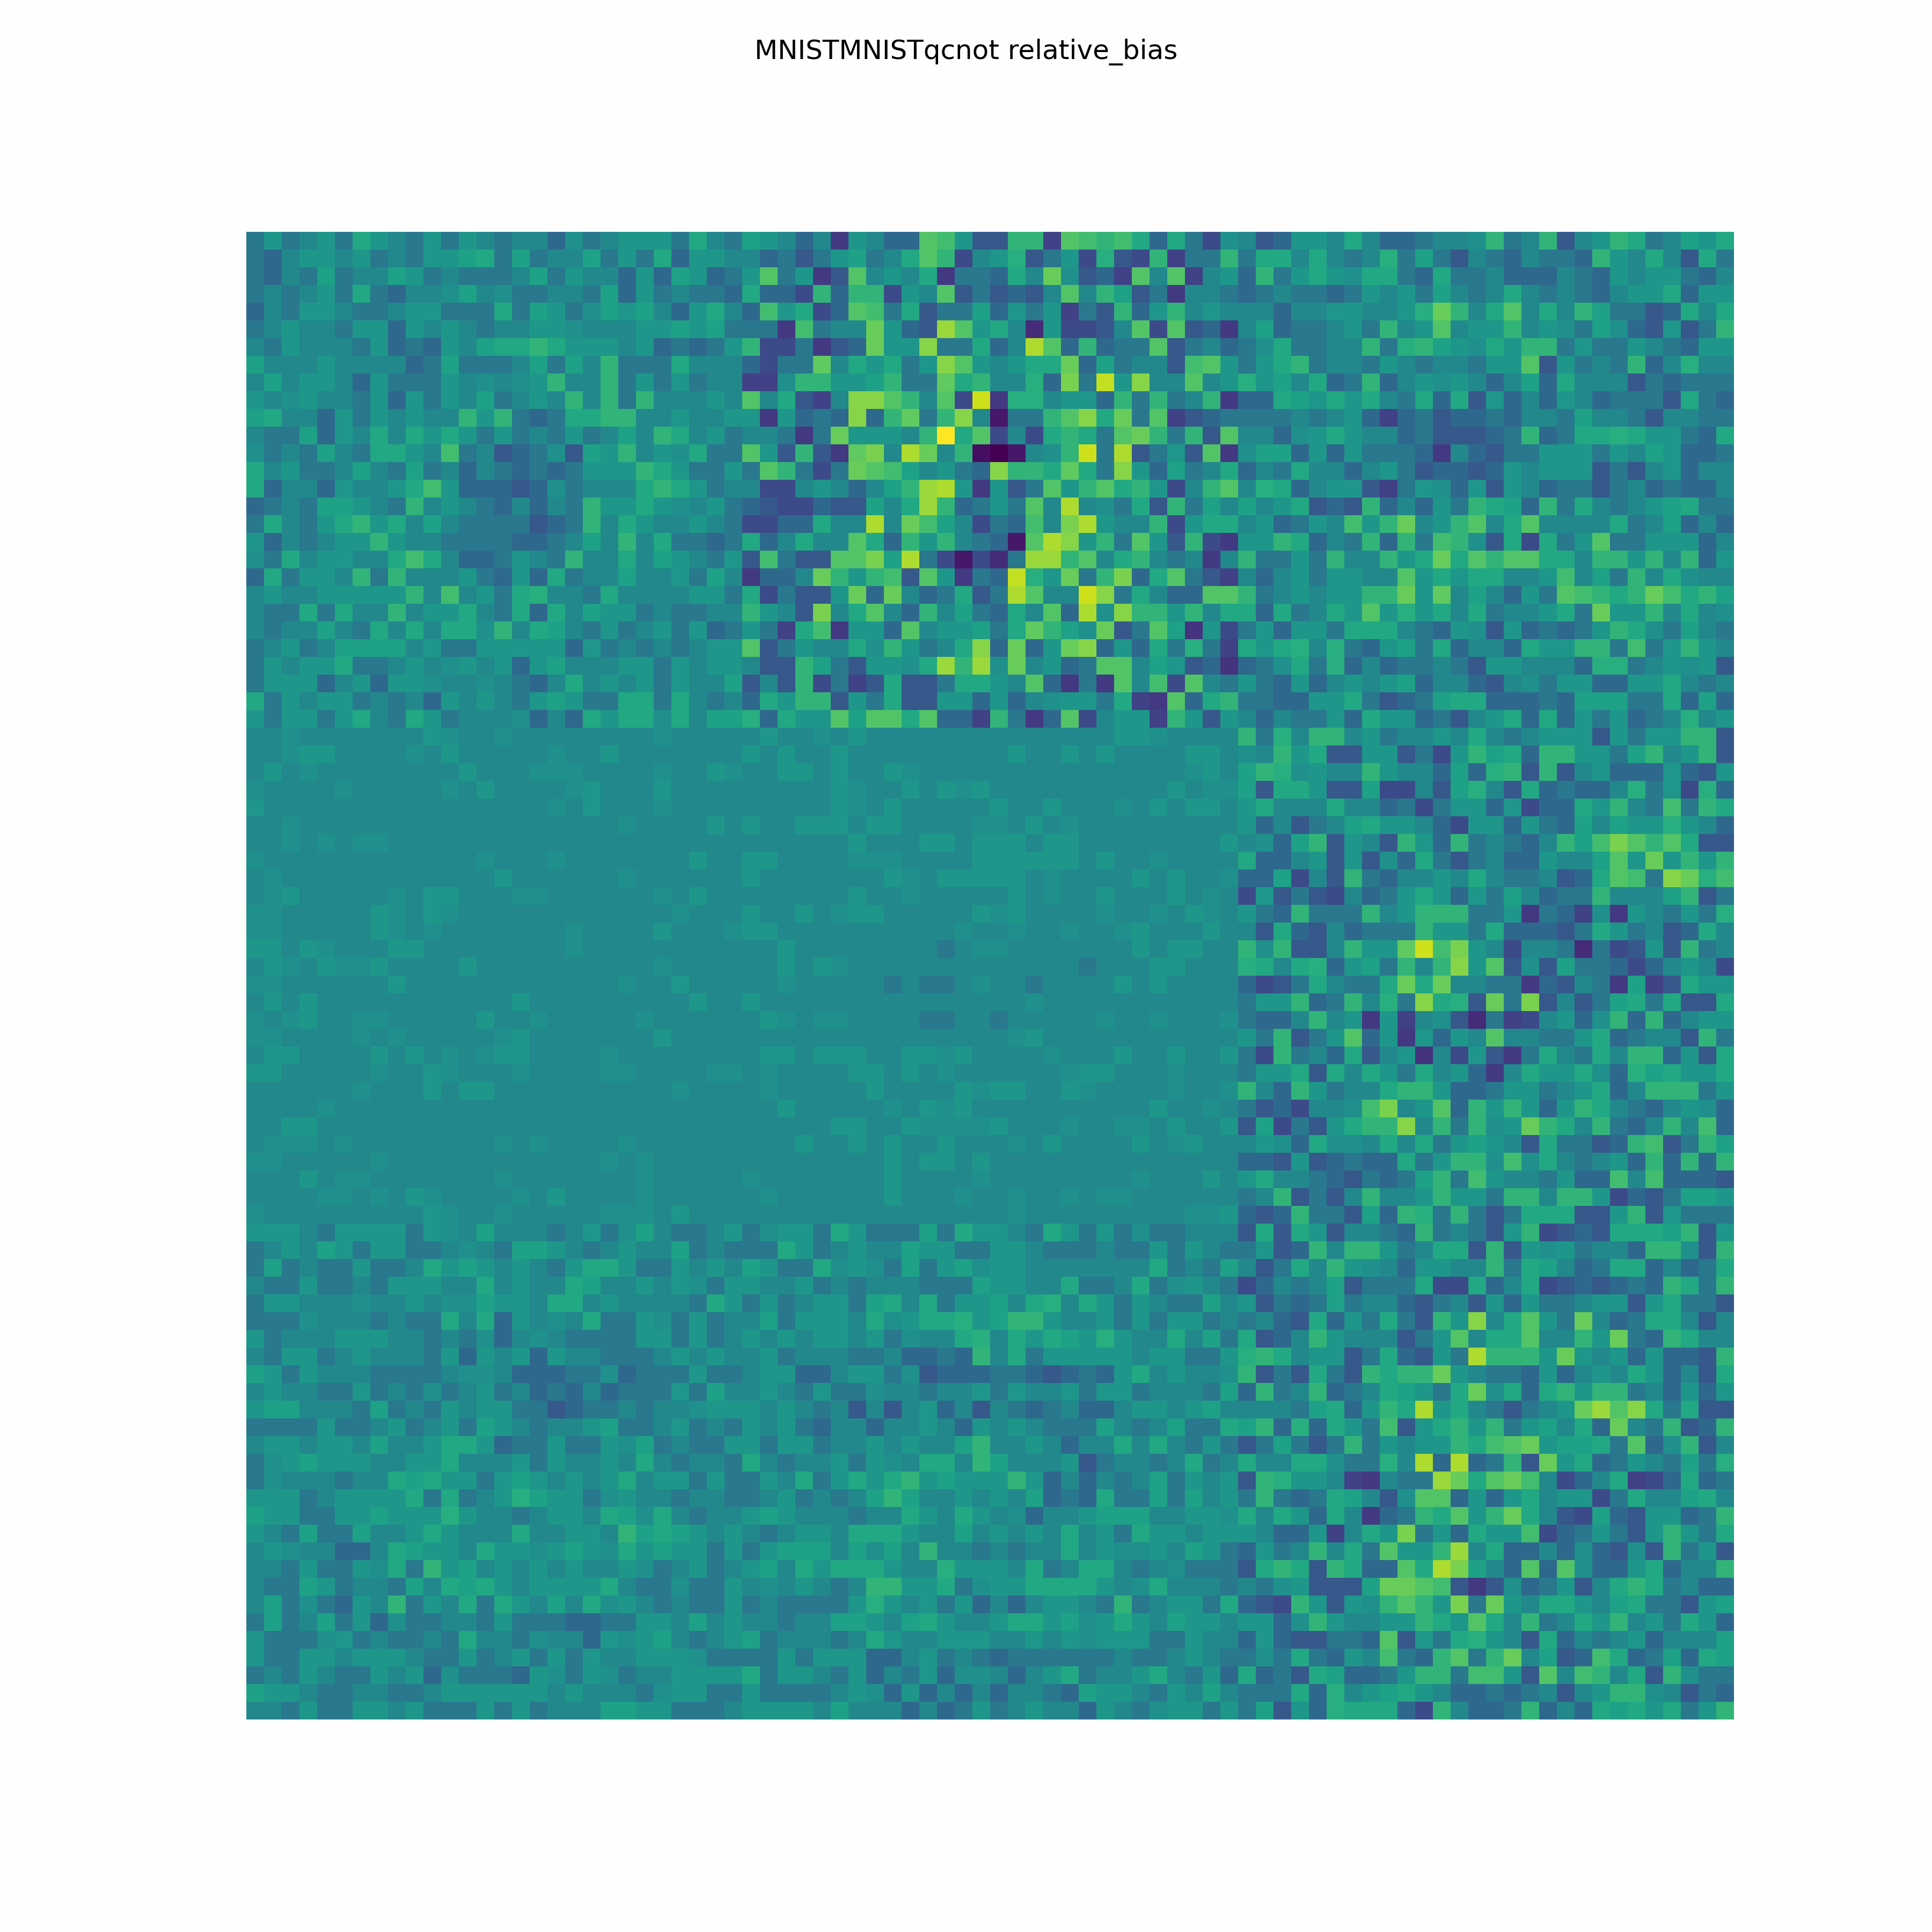

Slide 14
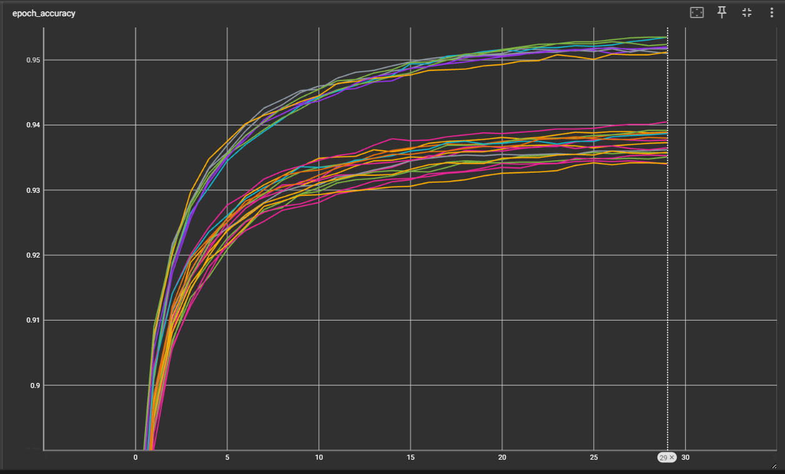

Slide 15
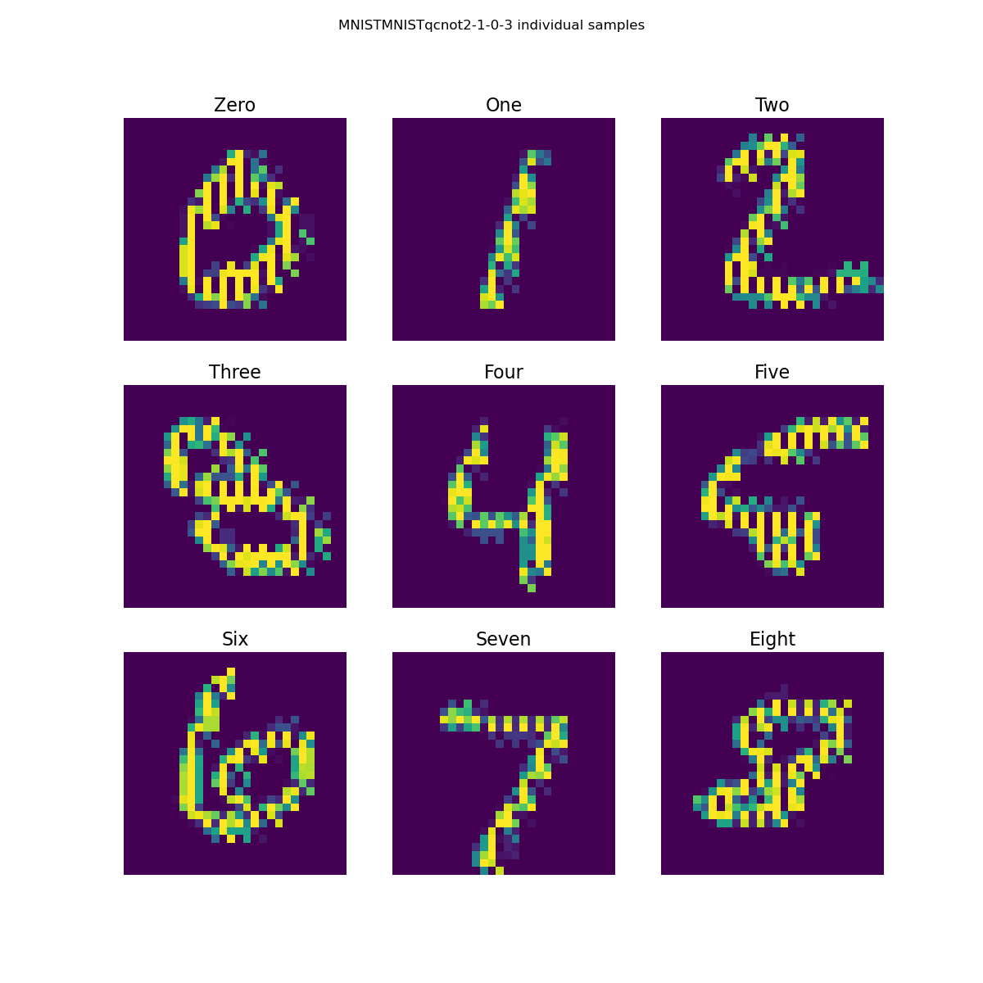
MNIST (2,1) (0,3) Accuracy 0.9535

Slide 16

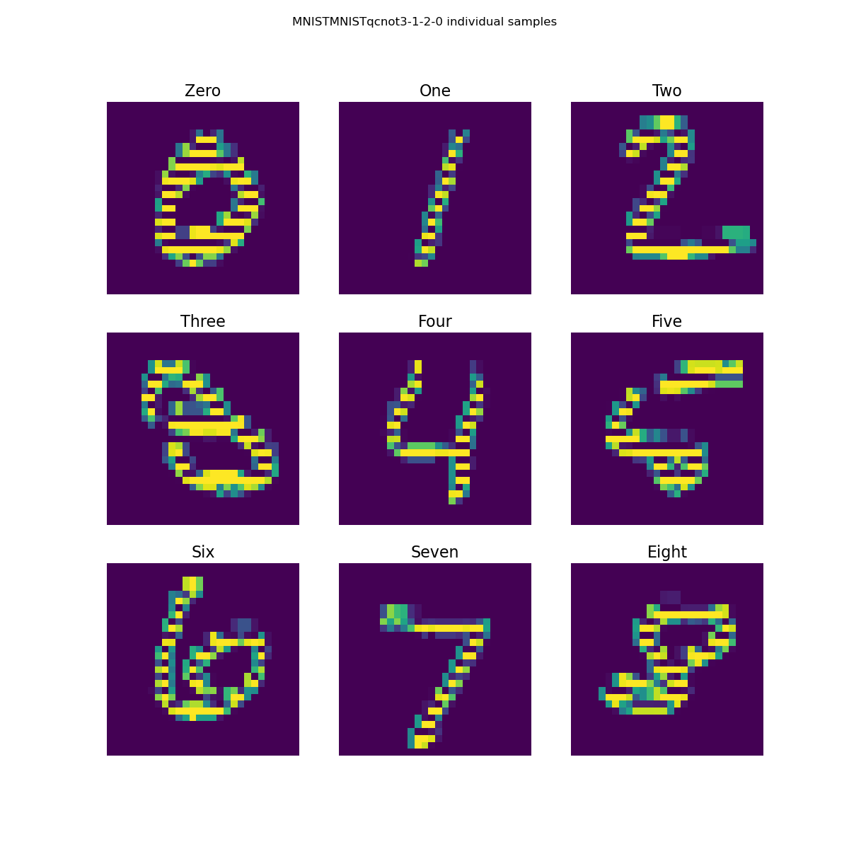
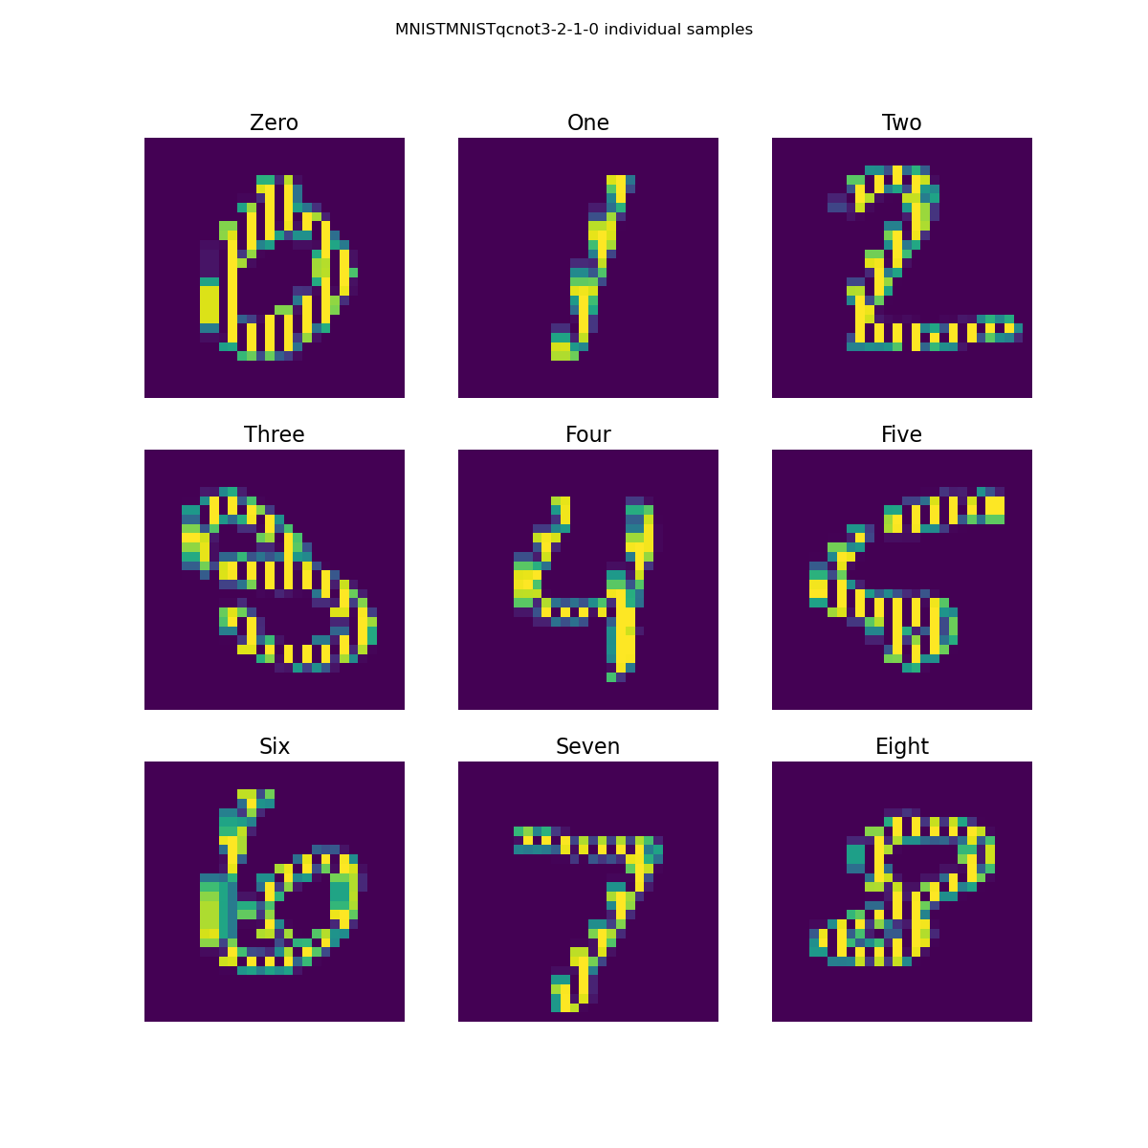
(3,0) (2,1)
(2,1) (0,3)
The gap in accuracy between the diagonal sets and other sets does not seem to be influenced by the resulting core horizontal or vertical segmentation. Instead, the more subtle difference in the edge features seems to influence the accuracy improvements in the diagonal sets.
(3,1) (2,0)
(3,2) (1,0)

Slide 17
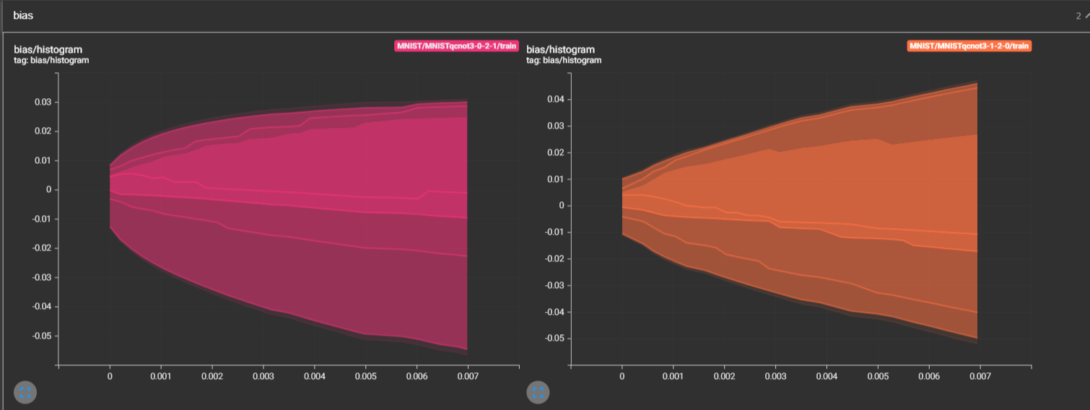
Evolution of Epoch Bias

Slide 18
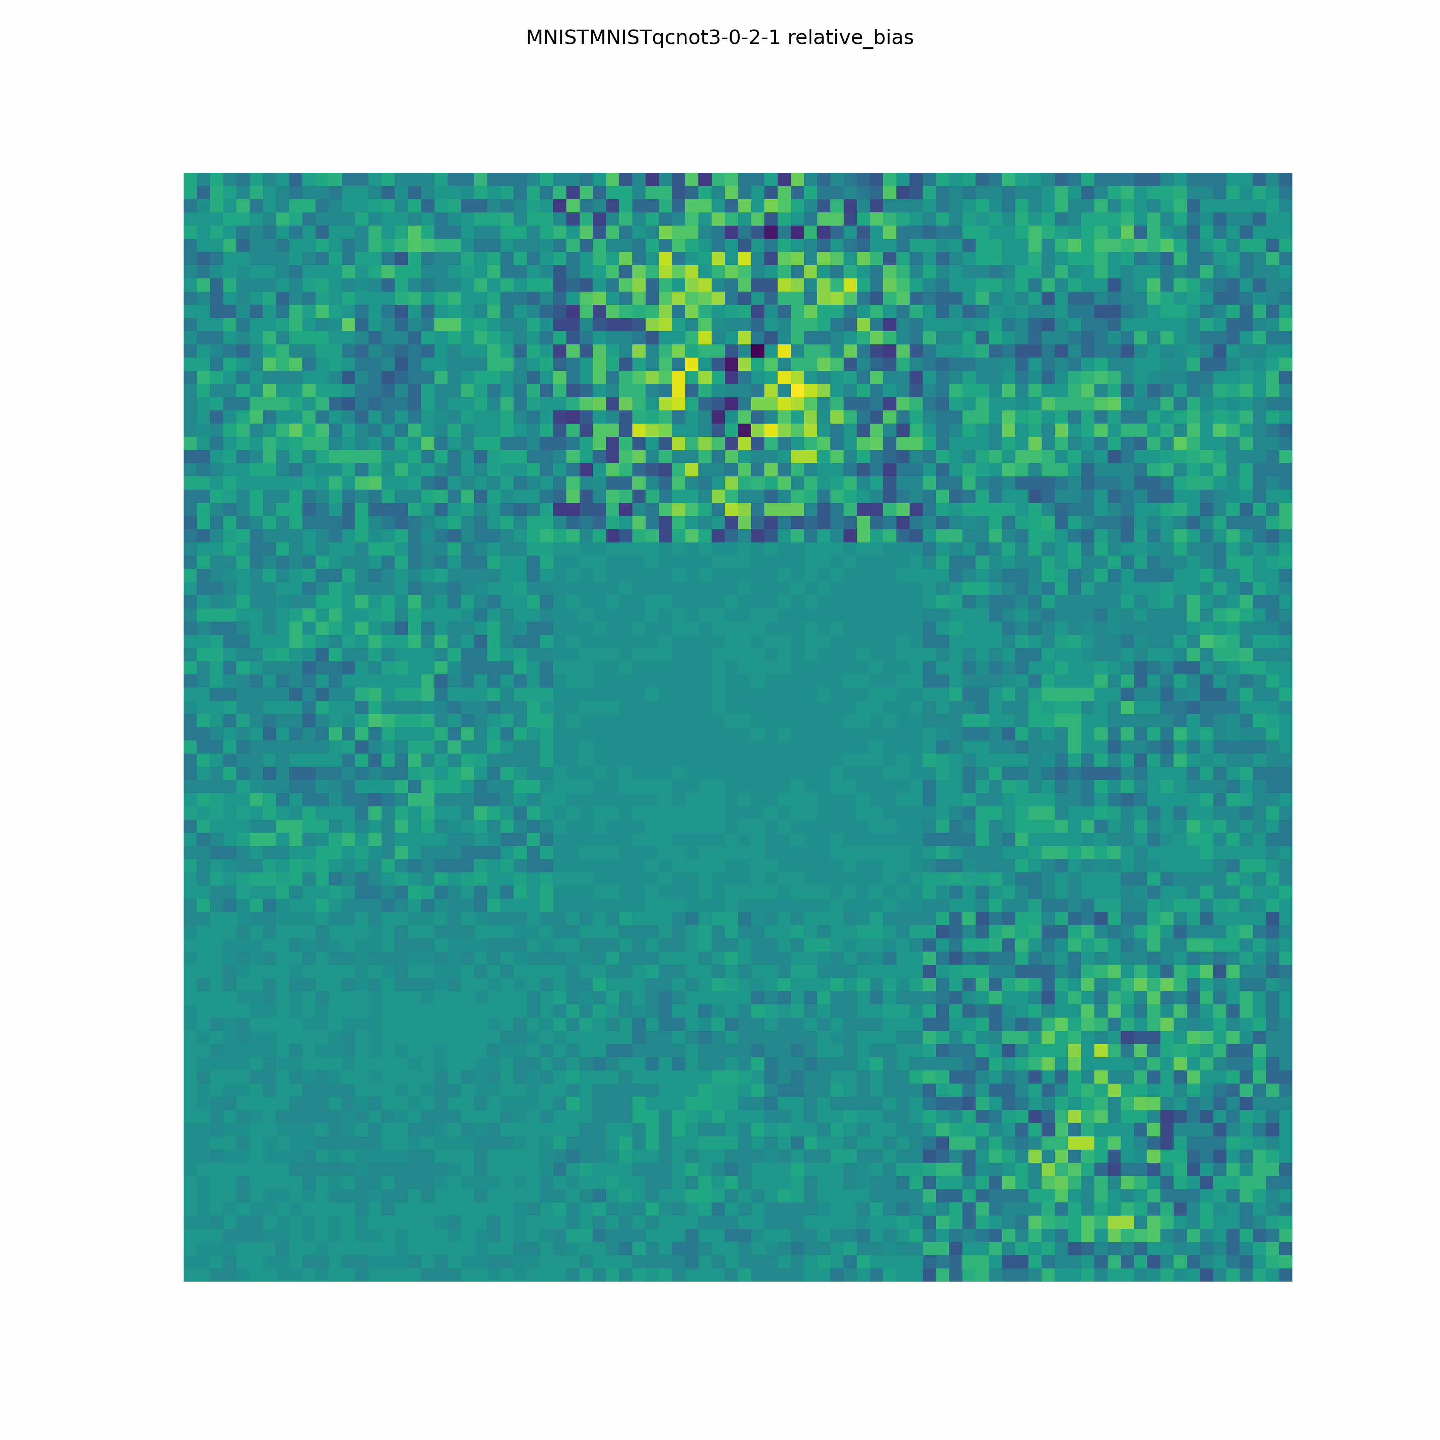
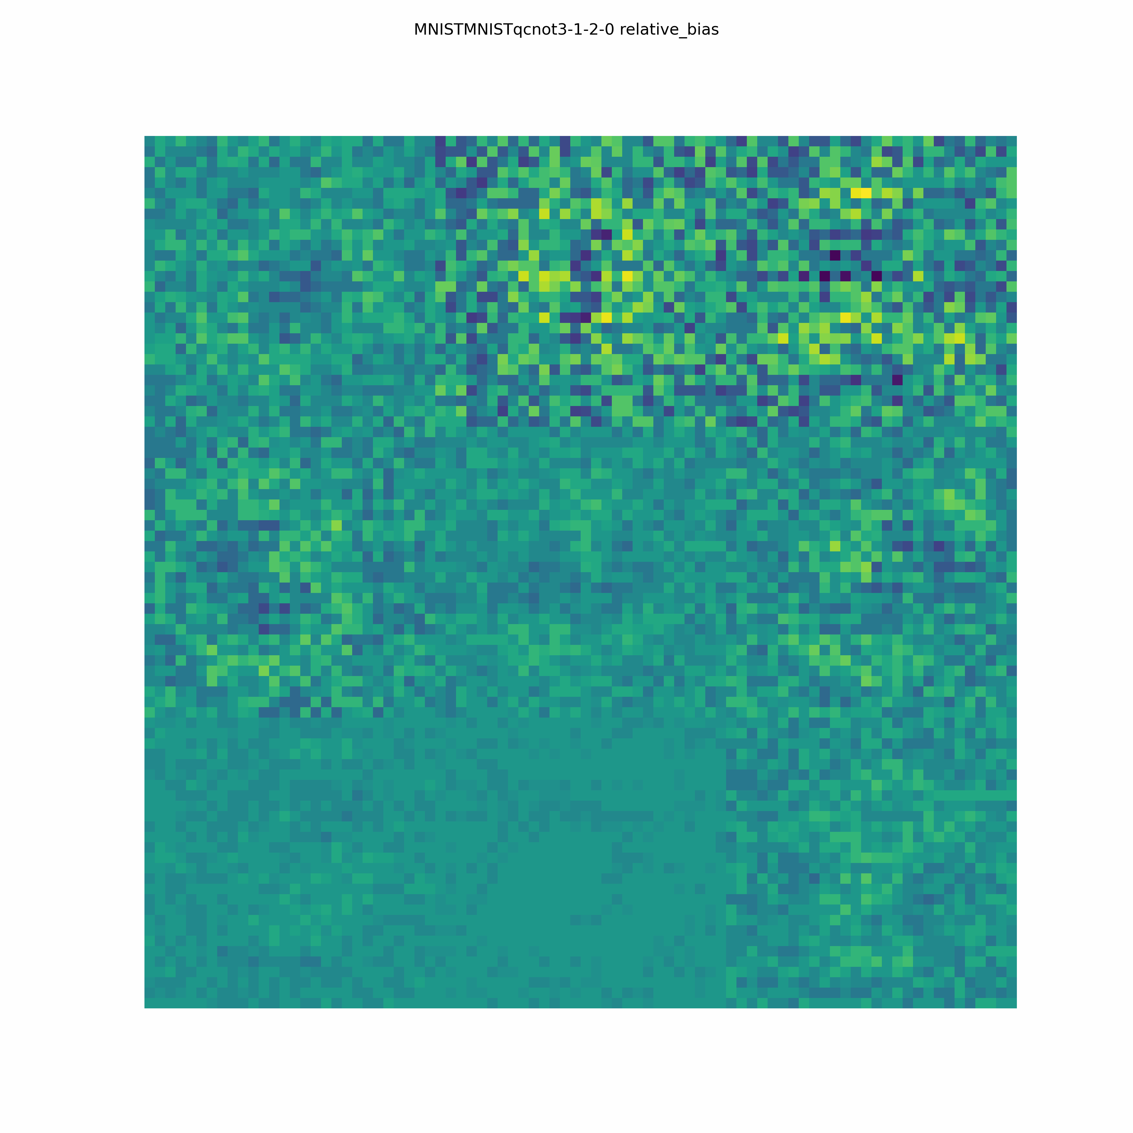

Slide 19
For the diagonal filters, the evolution of the dense layer’s learned weights in similar classes indicates differentiation of similar classes can improve if targetable pixels can be learned.
The target pixels are visible as extremely high weights in the model.

Slide 20
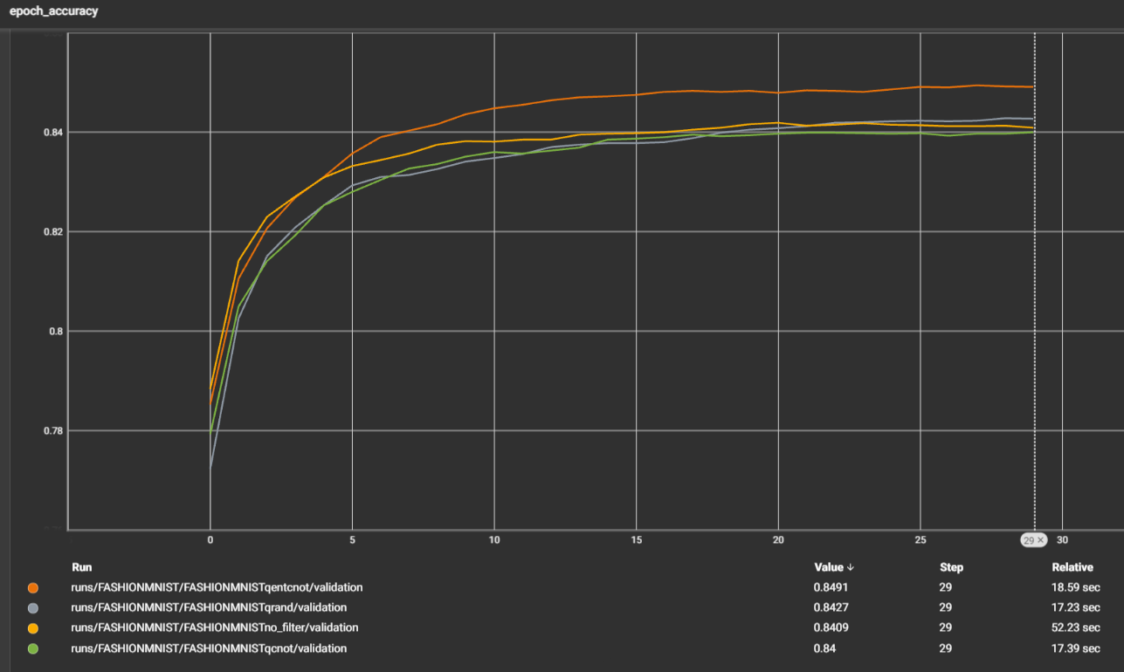

Slide 22
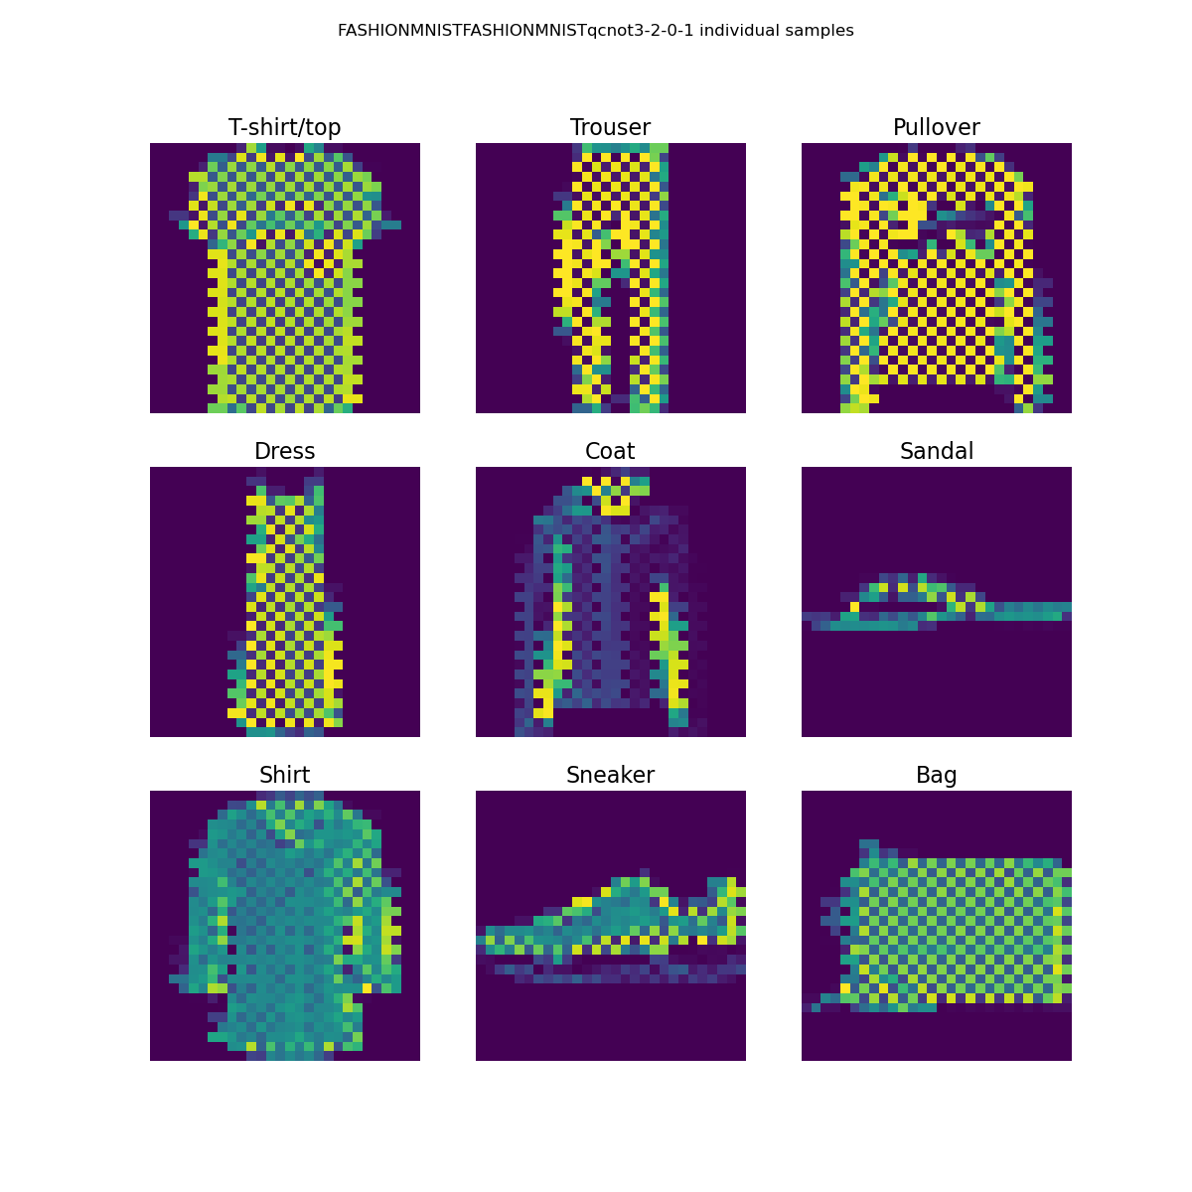
Fashion 2CNOT (3,2) (0,1) Accuracy 0.8458

Slide 24
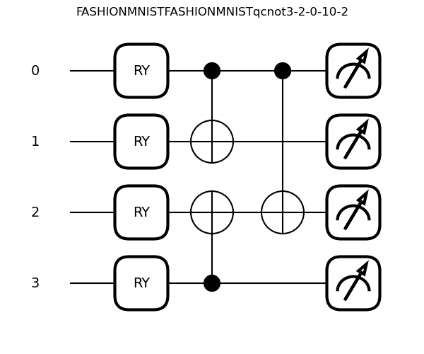
3 CNOT (3,2)(0,1)(0,2)

Slide 25
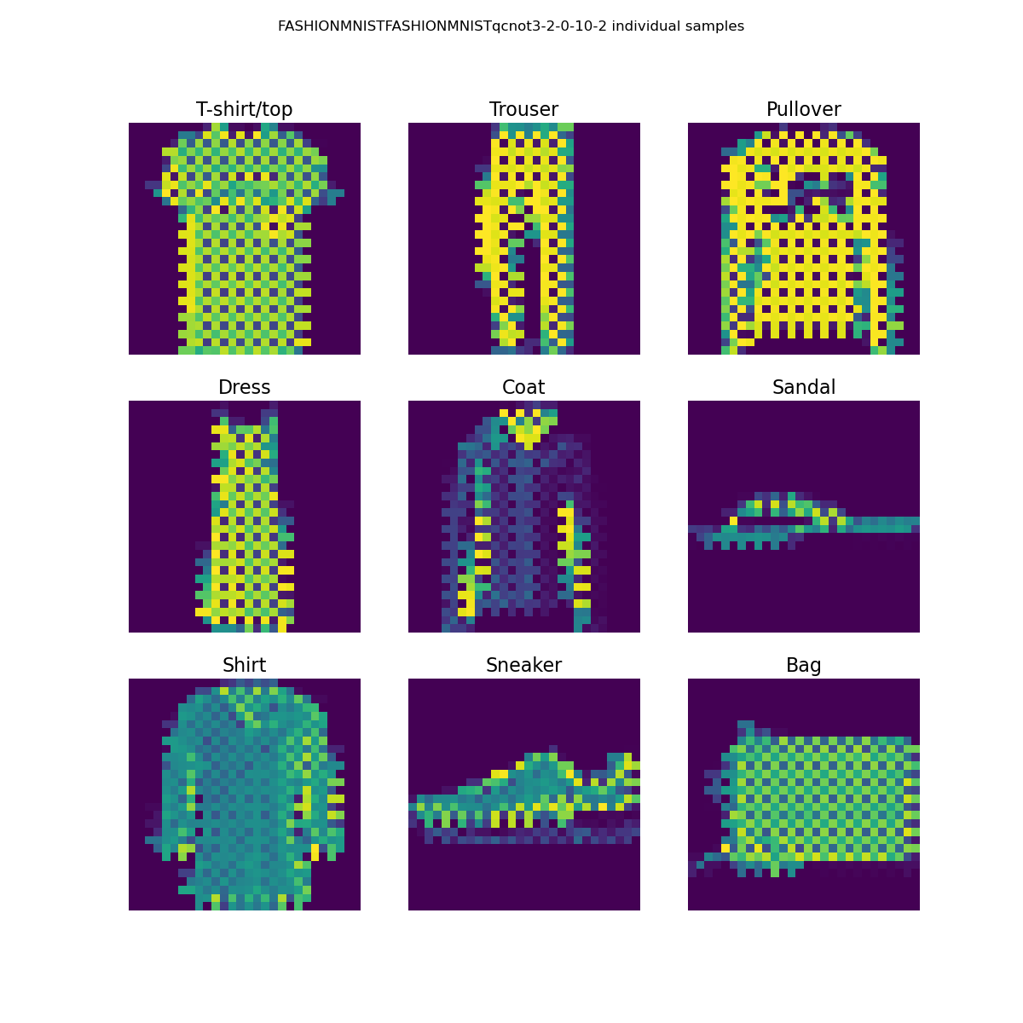
Fashion 3 CNOT Accuracy 0.8509

Slide 26
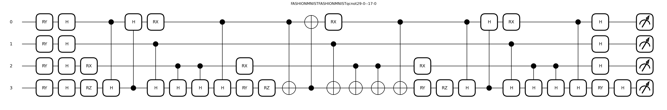
Random Layers with Seeds 29 and 17

Slide 27
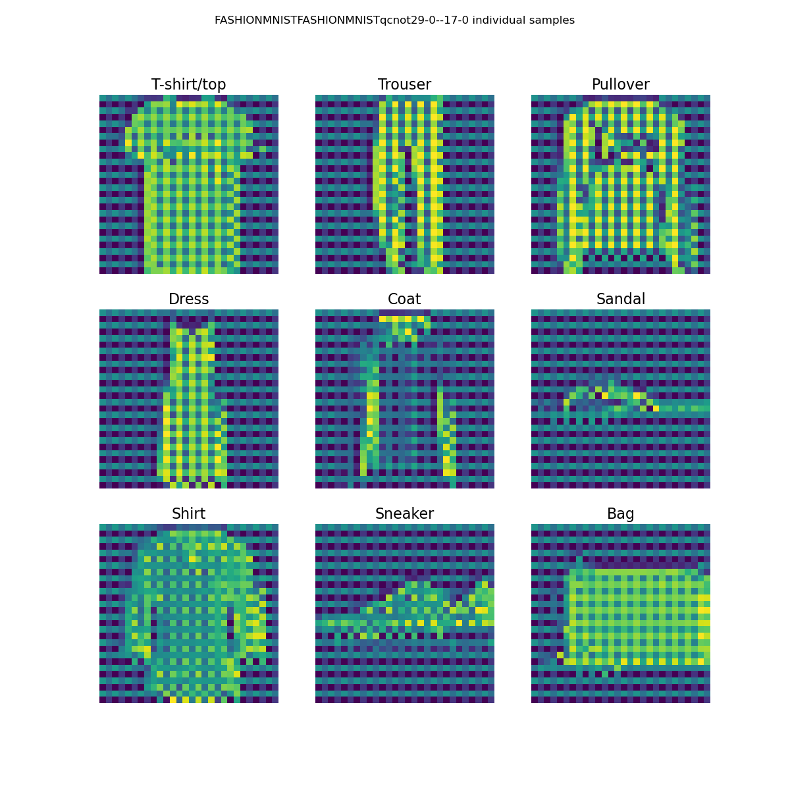
Fashion Random layers Accuracy 0.8539

Slide 28
On the fashion dataset with a 2x2 kernel the improved accuracy seems to include a mesh pattern
The improvement in accuracy is minimal compared to the unfiltered accuracy of 0.8409
Over thousands of variations of the 2x2 kernel, accuracy never exceeds 0.86

